Slide 1
Graphic Engineer

Slide 2

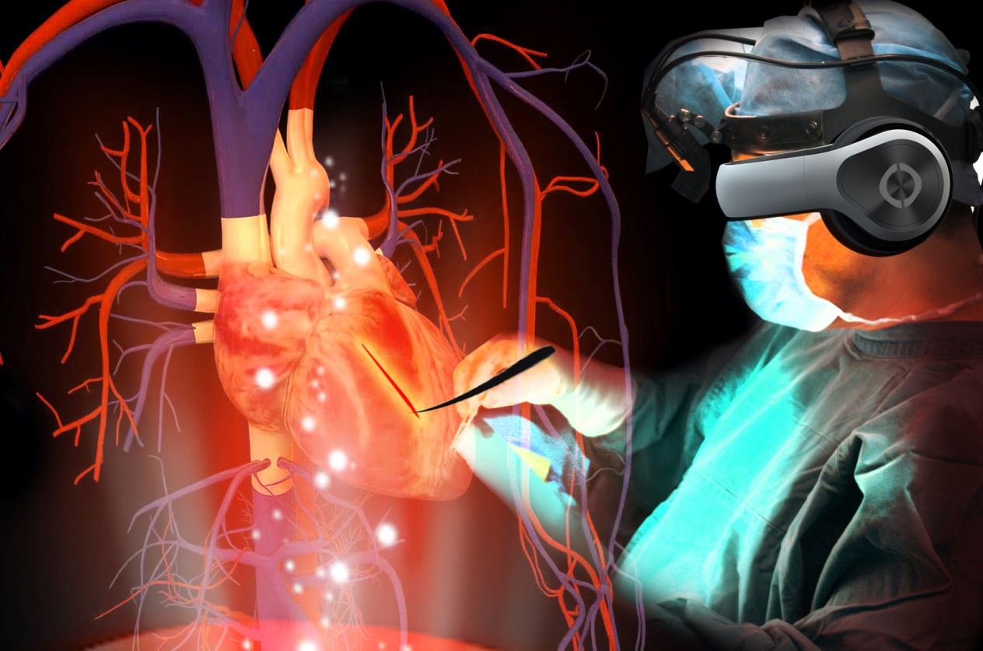
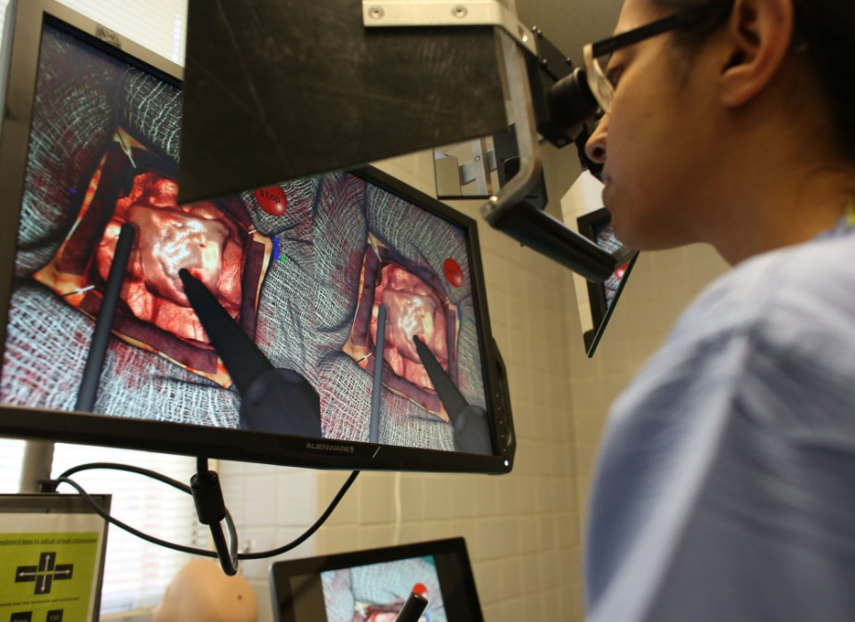
Virtual Training
of
Operations

Slide 3
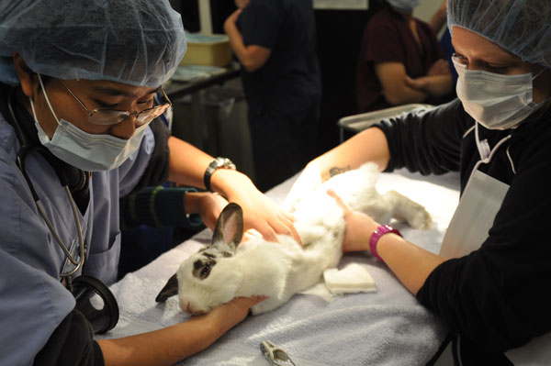

Dead bodys and animals

Slide 4

Expensive Unrepeatable

Slide 5
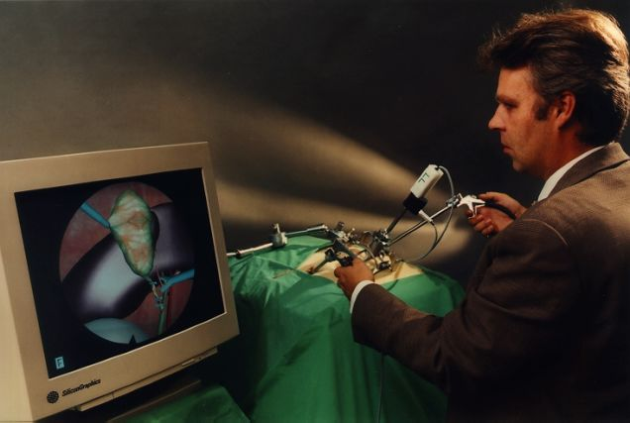

Slide 6


Slide 7
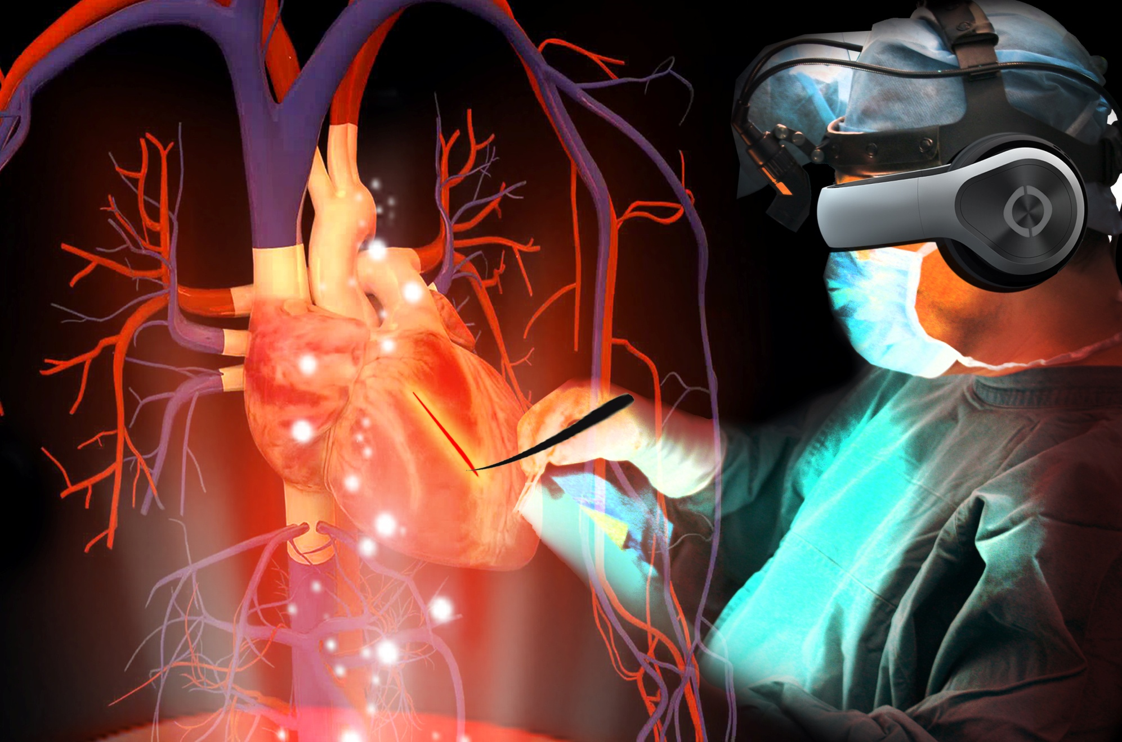

Slide 8


Slide 9
Big Three
Graphic
Compiler
OS

Slide 10
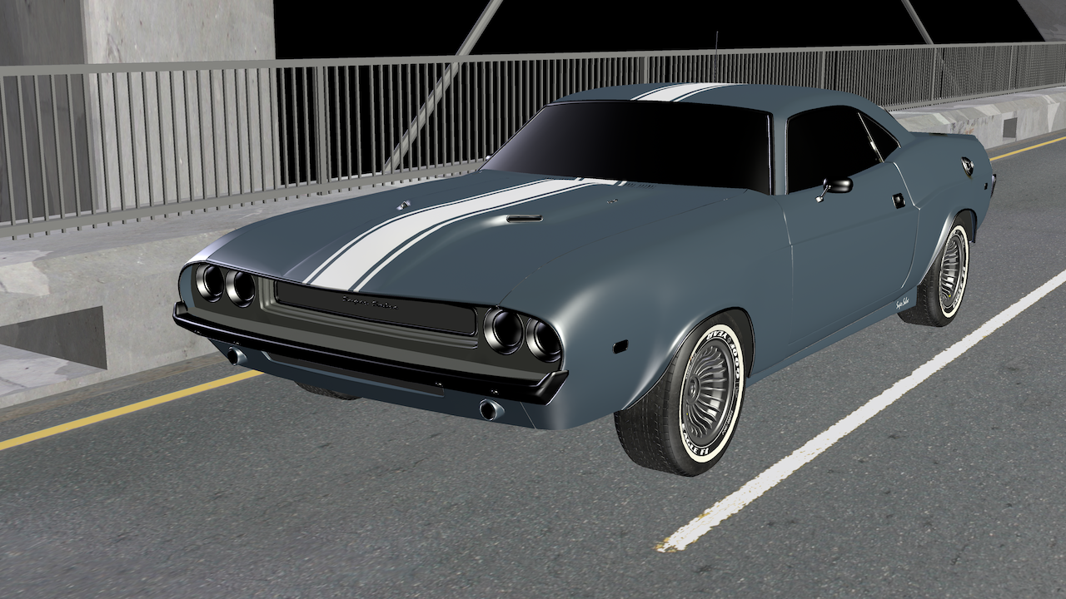
Before

Slide 11
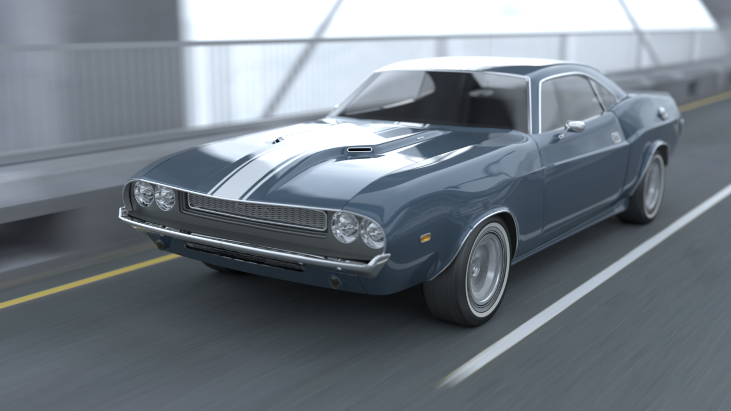
After

Slide 12

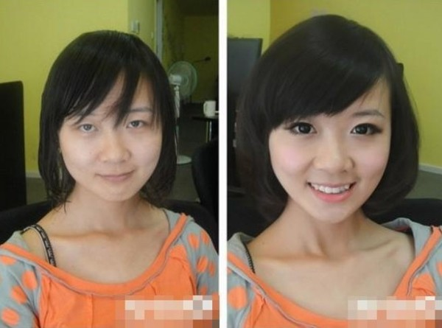

Slide 13


Two Direction
Real Time Render
Offline Render

Slide 14
HISTORY of CG
THE CONCEPT OF VIRTUAL REALITY IS
BASICALLY FROM 1950.
THEN IN 1965 –ULTIMATE DISPLAY
PEOPLE BECAME AWARE OF VR IN 1990s.

Slide 15
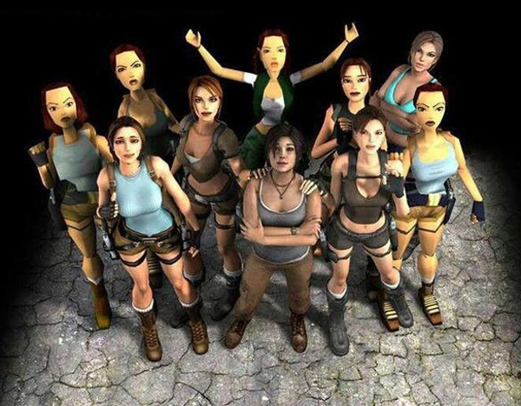
Evolution of Lora

Slide 16
Responsibility
* making the renderer efficient
* making visions beautiful
* graphic aligrithms for textures

Slide 17



Shader Languague
Cg/HLSL
GLSL
…

Slide 18
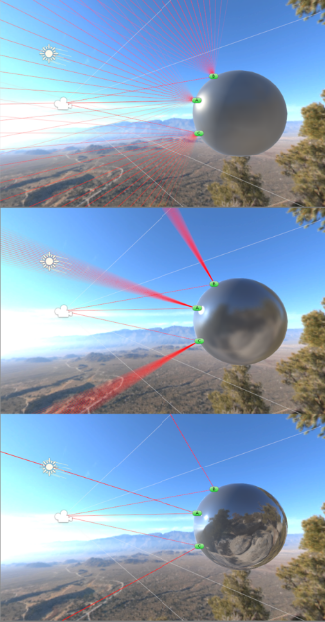
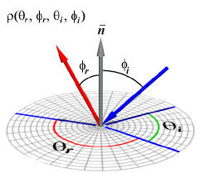
Physics Mathmatic Coding

Slide 19
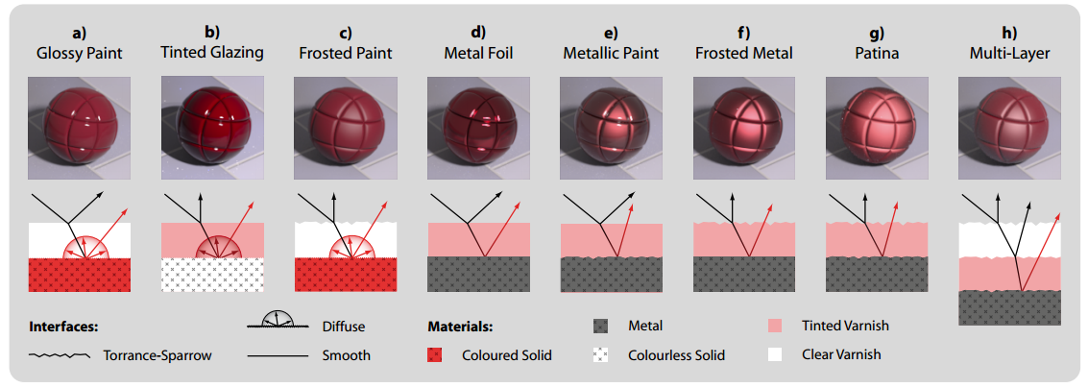
Diff Clac Diff Material

Slide 20
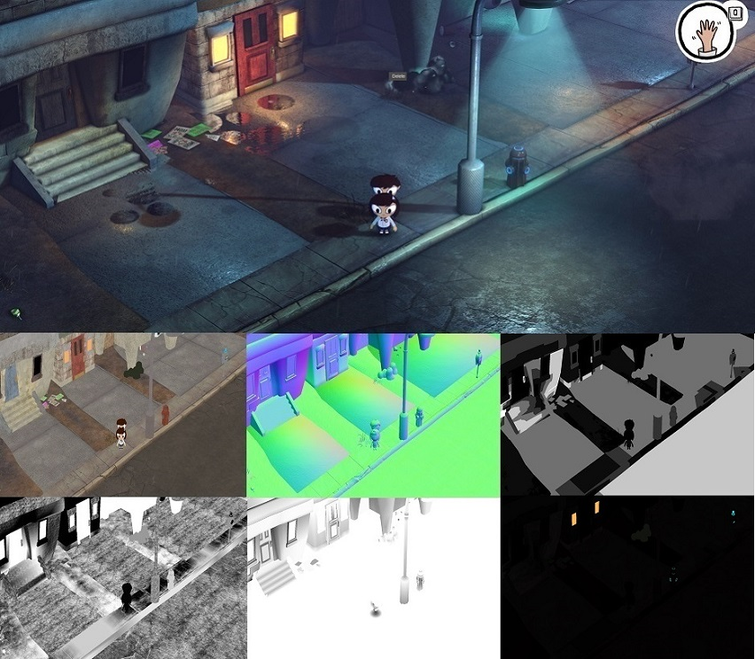

Slide 21
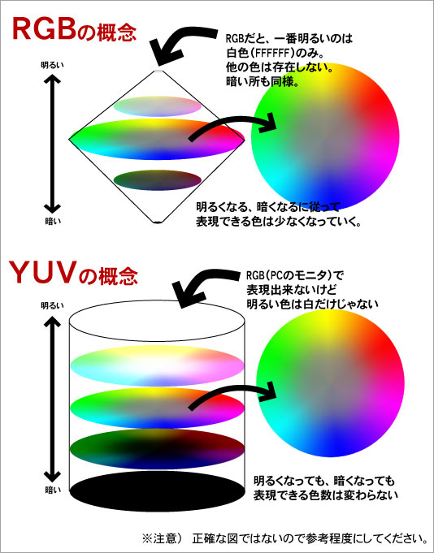
Algrithm of
translate
color format
form
RGB to YUV

Slide 22

LANGUAGE C or C++

Slide 23

Java

Slide 24
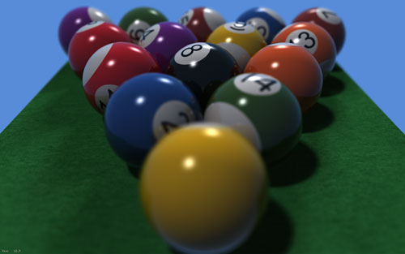


Slide 25
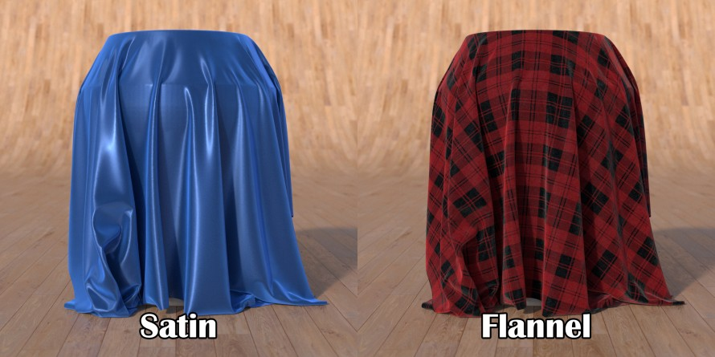
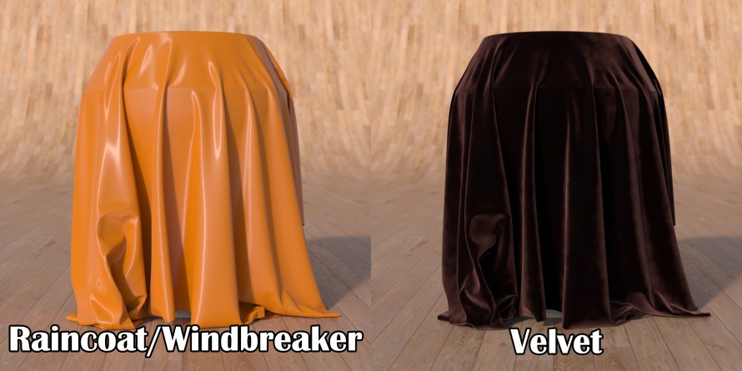

Slide 26
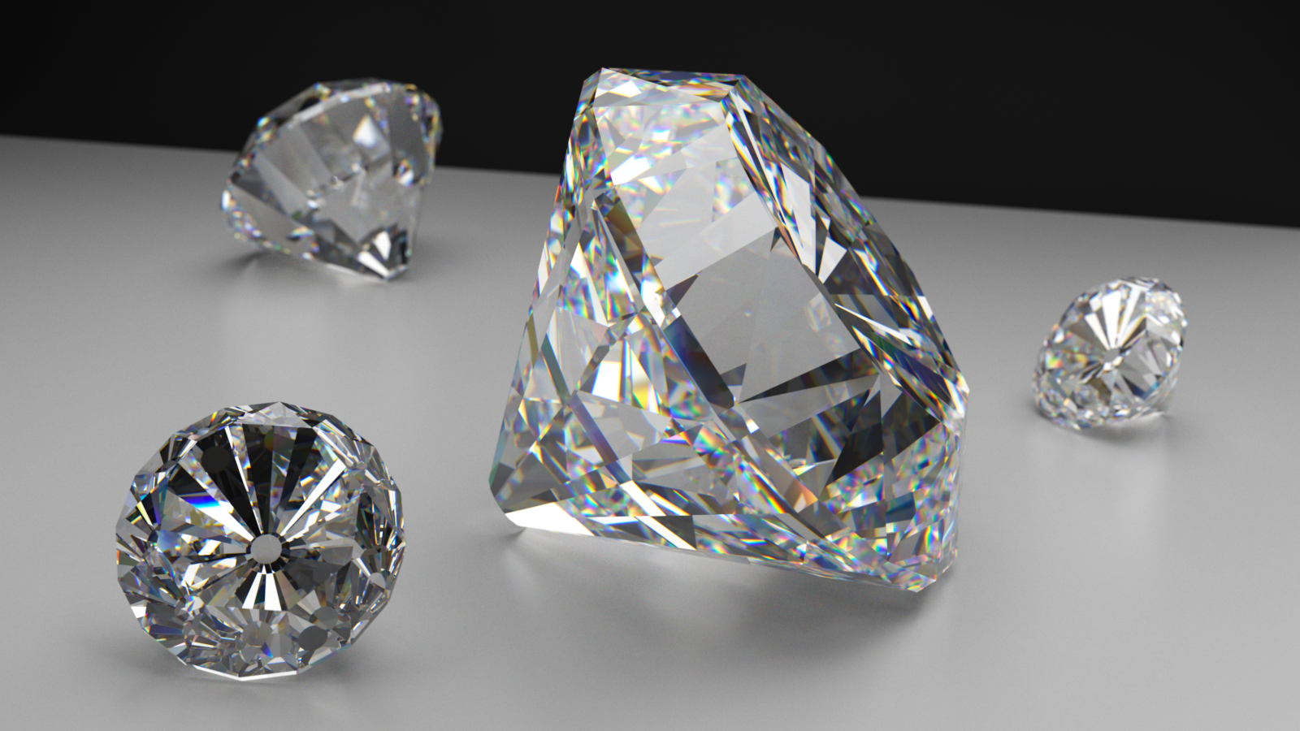

Slide 27
THANK YOU

